Slide 1

LANGUAGE LEARNING APPLICATION

Slide 2
Application Flow Chart

Slide 3
Launch of application
Login page
Homepage (language selection)
C Language
C++ Language
Python Language
JAVA Language
Content and Chapters

Slide 4
C_id
C_name
Enroll
L_id
L_name
L_login_id
Learner
Courses
L_email
C_content
L_password
Has
Login_to
Question
Ans_3
Quiz
Ques_id
Login
Ans_2
Correct_ans
Login_id
Login_pass
Ans_1

Slide 5
Estimated Time
Application will take approx.. 3 Month
for completion.
By 1st week of Nov.

Slide 6
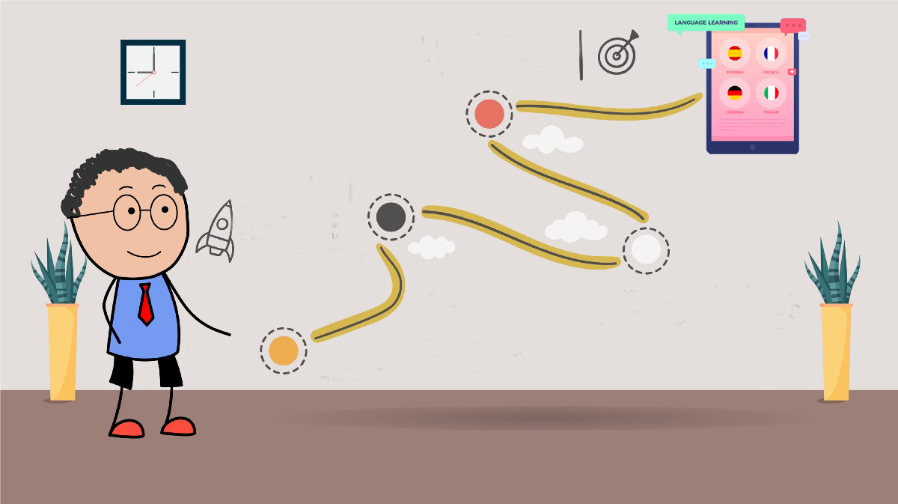
WEEK 12
Functional testing
Integration testing
WEEK 9-WEEK 11
Backend-
Implementing API’s using java.
Deploy
WEEK 4 – WEEK 5
Frontend-
Wireframing
Internal testing
WEEK 6- WEEK 8
Backend-
Configuration of databases.
Designing the API’s
WEEK 1- WEEK3
Frontend-
UI design
UI development

